Slide 1
Course Overview

Slide 2
Instructor
Yuvaraj Sambandan,
ysamband@my.centennialcollege.ca,
Department of Information and Communication Engineering Technology (ICET), SETAS, Centennial College.

Slide 3
Important Topics
Examine Android platform and Development Environment
Explore Kotlin Programming language
Create/use High level interface screen elements using Views and Jetpack Compose
Create Graphics and Animations
Android architectural and design patterns
Save data in a local database and Firebase Realtime database
Utilize Internet Resources in Android apps
Utilize Location and Maps APIs
Send/receive broadcasts and SMS messages
Develop and use Android services

Slide 4
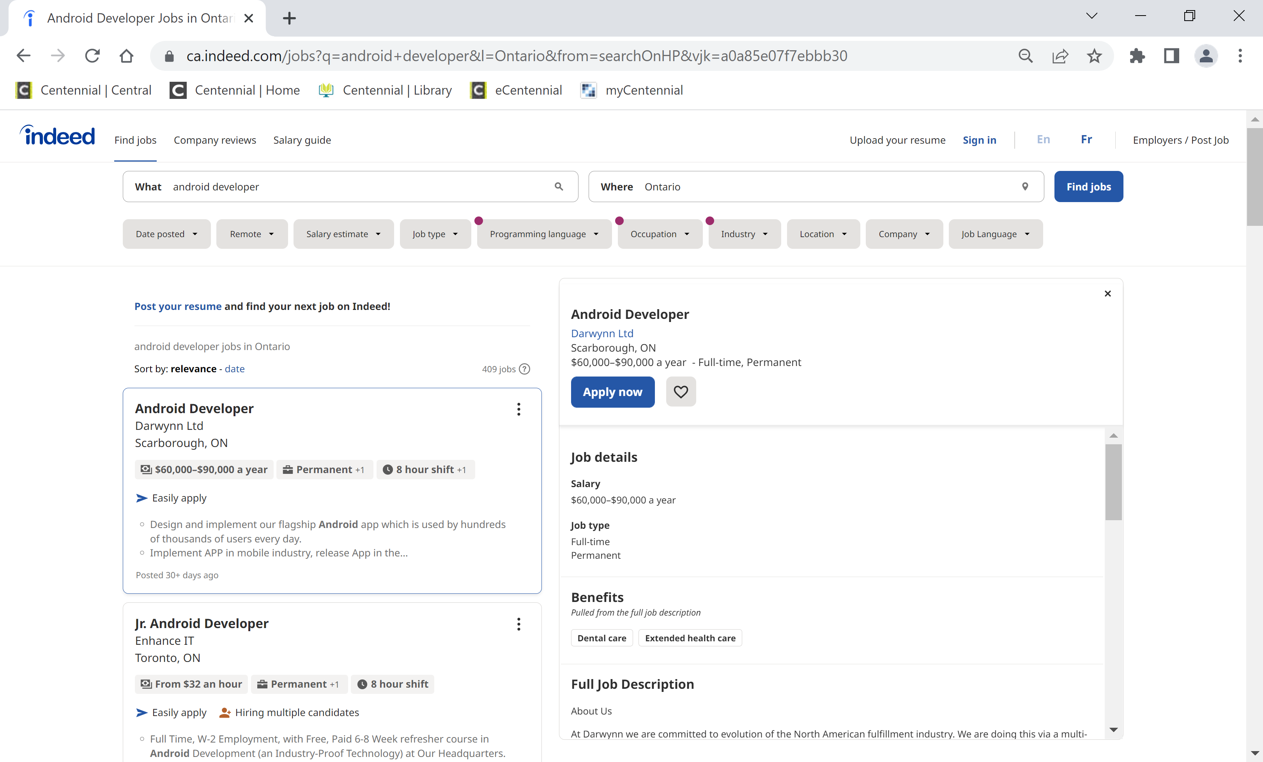
Android Jobs

Slide 5
The textbook and other materials
Reference books:
Griffiths D., Griffiths D., Head First Android Development, Third Edition, O’Reilly, 2022. Available on Safari IT Books Online.
Sills, B., Gardner , B., Marsicano, K., and Stewart, C.,, Android Programming: The Big Nerd Ranch Guide (5th edition), Copyright © 2022 Big Nerd Ranch, LLC. Available on Safari IT Books Online.
Android Documentation - https://developer.android.com/guide/index.html
Lecture Slides, Class Examples, Textbook examples

Slide 6
Evaluation
4 Lab Assignments – 50%
2 Hands-on tests – 50%

Slide 7
Evaluation
Submit Assignments on time
Unless announced otherwise:
24 hours late – 80%

Slide 8
Honesty Code
No Cheating
No plagiarism
Otherwise: very serious consequences, see the course outline for details.

Slide 9
Collaboration
Assignment discussions: encouraged and will take place in discussion forums.
However:
Implement your own solutions and understand it fully – I will ask you to explain the code.
You may use book(s), Lecture slides, Internet) for consultation:
However:
NEVER COPY the solutions from them

Slide 10
Before the start of each class
Have your Android Studio ready and running.
Have class examples posted on eCentennial ready (unzipped and stored in a folder created for this course).

Slide 11
Questions

